Slide 1




Empirical Software Engineering What is it and why do we need it?
Daniel Méndez
Blekinge Institute of Technology, Sweden
fortiss GmbH, Germany
www.mendezfe.org
mendezfe

Slide 2


Ground rules
(1)
Whenever you have questions / remarks, please don’t ask , but
share them with the whole group.
(2)
As we have to use ,
please feel free to interrupt me any time as I might not see you raising your hand.

Slide 3


What could be wrong with such a study?
Research Question: Which car has the best driving performance?
H_0: There is no difference.
20 people without a driving licence participate. They are taught to drive in a lecture of 2 hours.
Results: The BMW is significantly better than the Audi (p<0.01)
Empirical research is more than simply applying statistical equations
Adopted from: Dag I.K. Sjøberg, Keynote at the International Conference on Product-Focused SW Process Improvement 2016, Trondheim, Norway.
Image sources: Manufacturer websites

Slide 4
Goal of the lecture What is this little thing called “Empirical Software Engineering”?
Focus:
What & Why
What we will discuss
In a nutshell:
Broader perspective on Software Engineering (SE) as a scientific discipline
A few principles, concepts, and terms in Empirical SE
Why we need empiricism in Software Engineering research
What the perspectives are for the research community and for you
Basis for…
Course on research methods
Master Thesis projects
The time afterwards
Focus:
How

Slide 5
Outline
What is Empirical Software Engineering?
Why do we need Empirical Software Engineering?
What are the perspectives in Empirical Software Engineering?

Slide 6
Outline
What is Empirical Software Engineering?
Why do we need Empirical Software Engineering?
What are the perspectives in Empirical Software Engineering?

Slide 7
Let’s start step by step….
What is science?
-- What do you think? --

Slide 8
“Science” wasn’t built in a day…
Science is understood as the human undertaking for the search of knowledge (through systematic application of scientific methods)
Needs to be considered in a historical context
Increased understanding of scientific practice (and what science eventually is)
384-322 BC
…
1561-1626
…
1694-1778
1724-1804
…
1896-1980
1902-1994
…
Aristoteles
Bacon
Voltaire
Kant
Piaget
Popper
Search for laws and reasoning for phenomena
Understanding the nature of phenomena
Emancipation from gods and beliefs
Era of constructivism
Progress of knowledge of nature (reality)
Draw benefits from knowledge growth
Falsification as demarcation criterion
Birth of null hypothesis testing
System of Epistemology (theory of knowledge)

Slide 9

Scientific practices and research methods have changed over time, the role of empiricism* not
384-322 BC
Today
Le Petit Prince (1943)
Large Hadron Collider
* Gaining knowledge through sensory experiences

Slide 10
Scientific knowledge and practice
Scientific knowledge is the portrait of our understanding of reality (via scientific theories).
Necessary postulates for scientific practice (selected):
There are certain rules, principles, and norms for scientific practices
Rationalism: Reasoning by argument / logical inference / mathematical proof
Empiricism: Reasoning by sensory experiences (case studies, experiments,…)
There is nothing absolute about truth
There is a scientific community to judge about the quality of empirical studies

Slide 11
What is Software Engineering research? Is it scientific?
-- What do you think? --

Slide 12
Different purposes in science
Basic Science
Applied Science
Gaining and validating new insights
Often theoretical character
Typically addressed by natural and social sciences
Applying scientific methods to practical ends
Often practical (& pragmatic) character
Typically addressed by engineering disciplines
In software engineering research, we
apply scientific methods to practical ends (treating design science problems)
treat insight-oriented questions, thus, we are an insight-oriented science, too

Slide 13

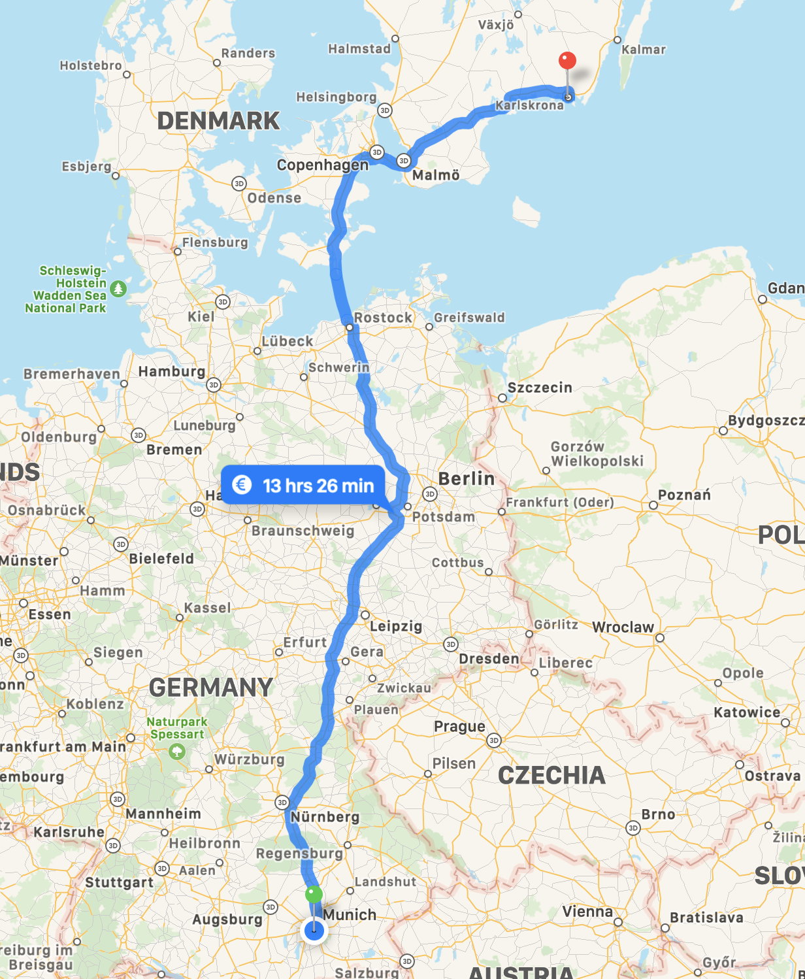
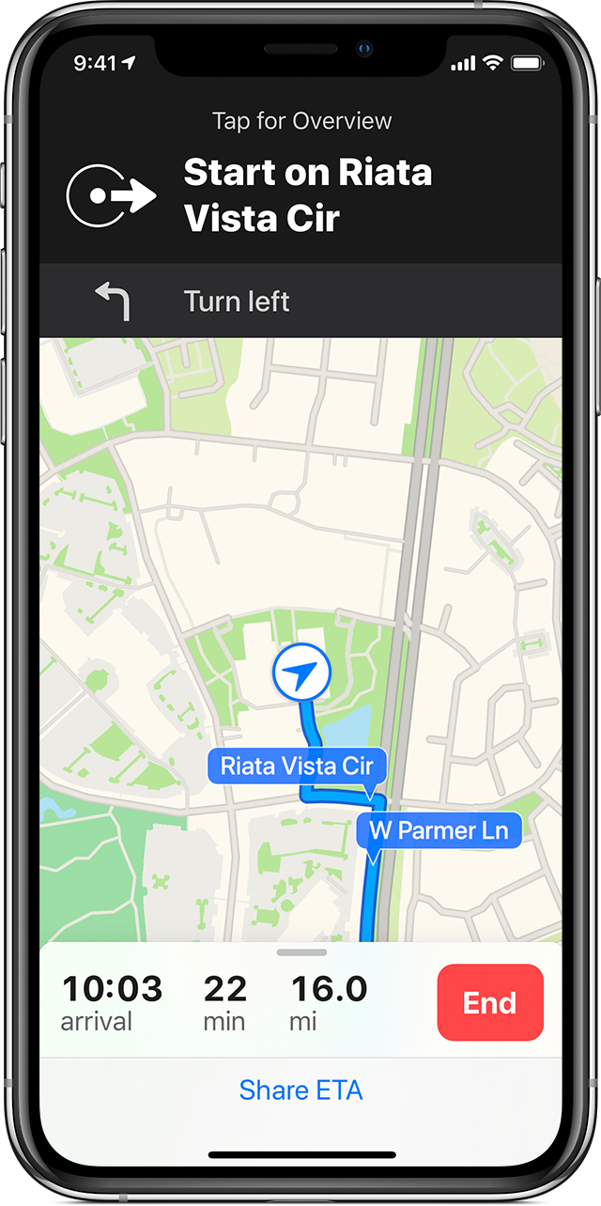
Different purposes in science
Basic Science
Applied Science
* Graph theory (Königsberg Bridge problem)
Fundamental / basic research
Applied research
Image Sources: Wikipedia (l), Apple (r)

Slide 14
What is Software Engineering research? Is it scientific?
-- Yes, Software Engineering research is scientific! --

Slide 15
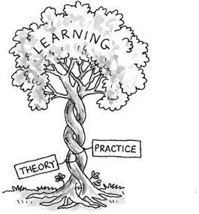
Empirical Software Engineering
The ultimate goal of Empirical Software Engineering is to advance our body of knowledge by building and evaluating theories.
Relevance from a theoretical and practical perspective:
Reason about the discipline and (e.g. social) phenomena involved
Recognise and understand limitations and effects of artefacts (e.g. by evaluating technologies, techniques, processes, models, etc.) in their practical contexts

Slide 16
But what is a Scientific Theory?
-- What do you think? --

Slide 17
Theories (generally speaking)
A theory is a belief that there is a pattern in phenomena.
Examples (following this general notion of theory):
“Earth is flat”
“Vaccinations lead to autism”
“Wearing face masks does more harm than the effects of COVID-19”
…
Are these theories scientific?
No: Speculations based on narrow views, imagination, and hopes and fears –often resulting in opinions that cannot be refuted (i.e. logical fallacies)

Slide 18
Scientific Theories
A scientific theory is a belief that there is a pattern in phenomena while having survived
tests against sensory experiences
criticism by critical peers
Note: Addresses so-called Demarcation Problem to distinguish science from non-science (as per introduction by K. Popper)
1. Tests
Experiments, simulations, …
Replications
2. Criticism
Peer reviews / acceptance in the community
Corroborations / extensions with further theories
In scope of empirical research methods (but out of scope for today)

Slide 19
Scientific Theories have…
… a purpose:
 | Analytical | Explanatory | Predictive | Explanatory & Predictive
Scope | Descriptions and conceptualisation, including taxonomies, classifications, and ontologies - What is? | Identification of phenomena by identifying causes, mechanisms or reasons - Why is? | Prediction of what will happen in the future - What will happen? | Prediction of what will happen in the future and explanation - What will happen and why?
Note: Law “versus” Theory A law is a descriptive theory without explanations (i.e. an analytical theory)
… quality criteria:
Testability
Level of confidence („relation to existing evidence“)
Usefulness to researchers and practitioners („impact and implications“)
…
Adapted from: Sjøberg, D., Dybå, T., Anda, B., Hannay, J. Building Theories in Software Engineering, 2010.
Further information on: https://goo.gl/SQQwxt

Slide 20
Exemplary framework for describing theories in Software Engineering
Constructs: What are the basic elements? (Actors, technologies, activities, system entities, context factors)
Propositions: How do the constructs interact?
Explanations: Why are the propositions as specified?
Scope: What is the universe of discourse in which the theory is applicable?
Source (framework): Sjøberg, D., Dybå, T., Anda, B., Hannay, J. Building Theories in Software Engineering, 2010.
Source (example): Wagner, Mendez et al. Status Quo in Requirements Engineering: A Theory and a Global Family of Surveys, TOSEM 2018.

Slide 21
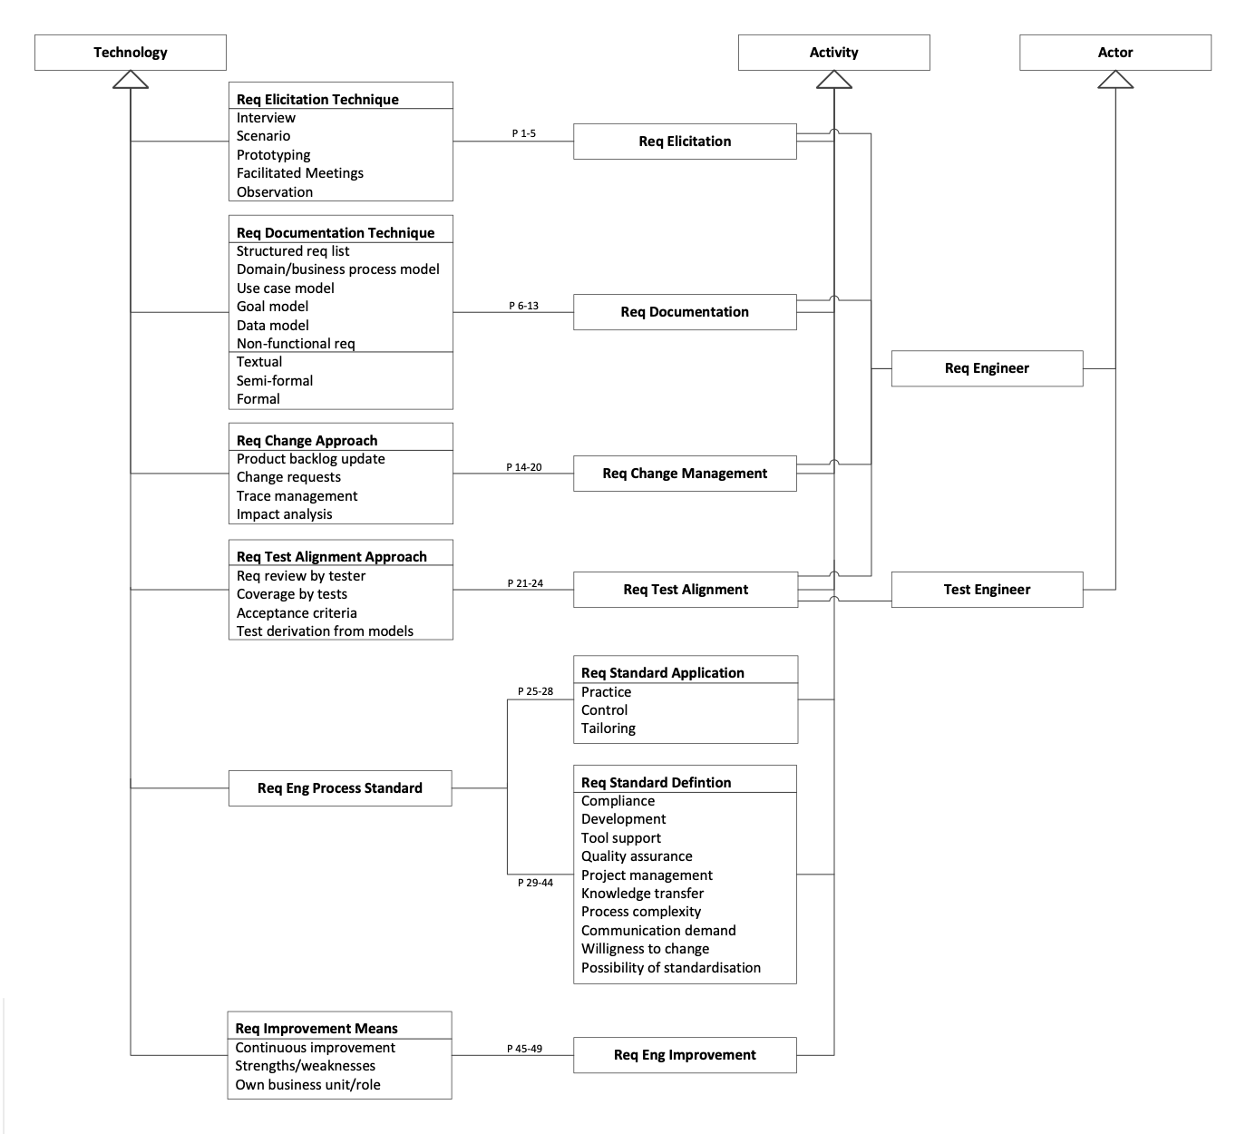

Exemplary framework for describing theories in Software Engineering
Example
Constructs: What are the basic elements? (Actors, technologies, activities, system entities, context factors)
Propositions: How do the constructs interact?
Explanations: Why are the propositions as specified?
Scope: What is the universe of discourse in which the theory is applicable?
Proposition:
“Structured requirements lists are documented textually in free form or textually with constraints.”
Explanation and Scope:
“Free-form and constraint textual requirements are sufficient for many contexts such as in agile projects where they only act as reminders for further conversations.”
Source (framework): Sjøberg, D., Dybå, T., Anda, B., Hannay, J. Building Theories in Software Engineering, 2010.
Source (example): Wagner, Mendez et al. Status Quo in Requirements Engineering: A Theory and a Global Family of Surveys, TOSEM 2018.

Slide 22
Theories and hypotheses
Note: We don’t “test theories”, but their consequences via hypotheses (i.e. testable propositions)
Scientific theory
“[…] based on hypotheses tested and verified multiple times by detached researchers” (J. Bortz and N. Döring, 2003)
Hypothesis
“[…] a statement that proposes a possible explanation to some phenomenon or event” (L. Given, 2008)
Grounded in theory, testable and falsifiable
Often quantified and written as a conditional statement
Theory / Theories
Theory (Pattern) Building
Hypothesis Building
(Tentative) Hypothesis
Falsification / Corroboration
Empirical Approaches
If cause/assumption (independent variables)
then (=>) consequence (dependent variables)

Slide 23




From real world phenomena to theories and back: The empirical life cycle
Theory / Theories
Abduction
(Creative) Synthesis of an explanatory case from a general rule and a particular result (observation)
Theory (Pattern) Building
Hypothesis Building
Induction
Deduction
Inference of a general rule from a particular case/result (observation)
(Tentative) Hypothesis
Application of a general rule to a particular case, inferring a specific result
Falsification / Corroboration
Empirical Approaches
Empirical Inquiries
Units of Analysis
Sampling Frame
Sampling
Source: Mendez and Passoth. Empirical Software Engineering: from Discipline to Interdiscipline, 2018.

Slide 24
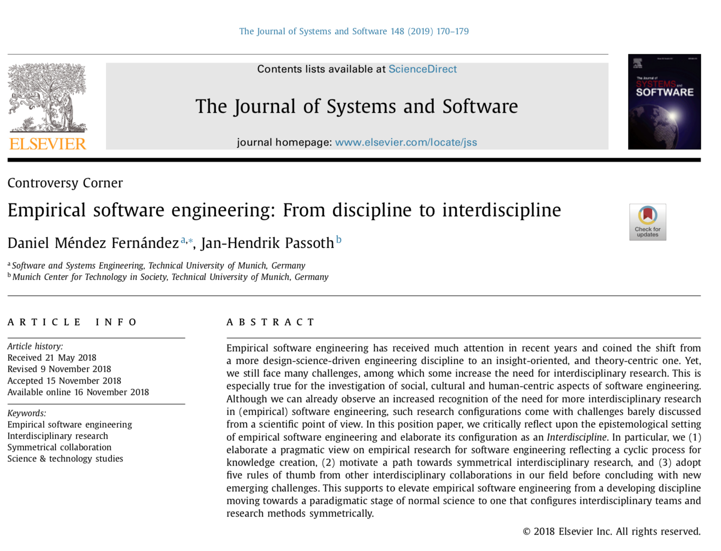
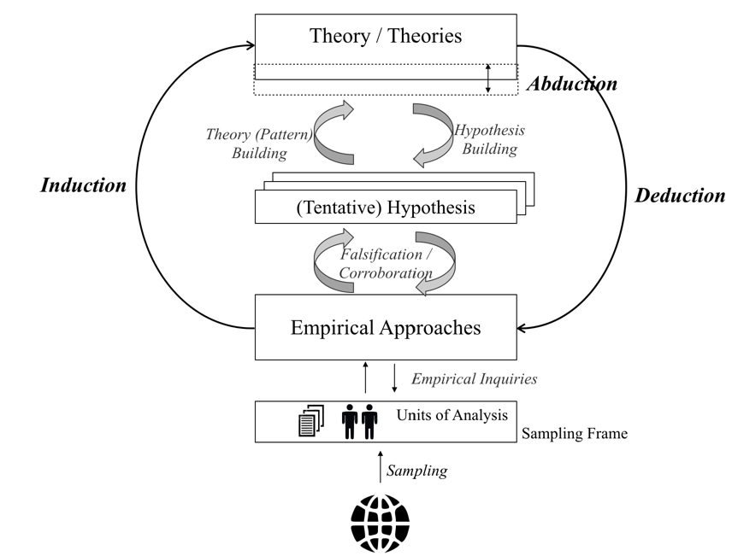
From real world phenomena to theories and back: The empirical life cycle
Further reading and outlook
Theory / Theories
Abduction
(Creative) Synthesis of an explanatory case from a general rule and a particular result (observation)
Theory (Pattern) Building
Hypothesis Building
Induction
Deduction
Inference of a general rule from a particular case/result (observation)
(Tentative) Hypothesis
Application of a general rule to a particular case, inferring a specific result
Falsification / Corroboration
Empirical Approaches
Preprint: https://arxiv.org/abs/1805.08302
Empirical Inquiries
Units of Analysis
Epistemological setting of Empirical Software Engineering
Theory building and evaluation
Challenges in Empirical Software Engineering
Sampling Frame
Sampling
Source: Mendez and Passoth. Empirical Software Engineering: from Discipline to Interdiscipline, 2018.

Slide 25
Outline
What is Empirical Software Engineering?
Why do we need Empirical Software Engineering?
What are the perspectives in Empirical Software Engineering?

Slide 26
Empirical Software Engineering
RECAP
The ultimate goal of Empirical Software Engineering is to advance our body of knowledge by building and evaluating theories.
Relevance from a theoretical and practical perspective:
Reason about the discipline and (e.g. social) phenomena involved
Recognise and understand limitations and effects of artefacts (e.g. by evaluating technologies, techniques, processes, models, etc.) in their practical contexts

Slide 27
What are exemplary scientific Software Engineering Theories?
-- Which ones do you know? --

Slide 28

Scientific Theories in Software Engineering
Transferred verbatim from other disciplines (i.e. not adopted)
Example: Theory of Gatekeeping
Isolated and vague (i.e. universal)
Example: “Frontloading efforts decreases overall development costs”
Not backed by evidence (i.e. non-scientific conventional wisdom)
Example: “GoTo statements are harmful”
Disclaimer: Symbolic statement, might be slightly over exaggerated
Image Source: https://www.worldwildlife.org/habitats/deserts

Slide 29
Current state of evidence in Software Engineering
“[…] judging a theory by assessing the number, faith, and vocal energy of its supporters […] basic political credo of contemporary religious maniacs”
— Imre Lakatos, 1970
* Addressing the situation in the quantum mechanics research community, an analogy

Slide 30
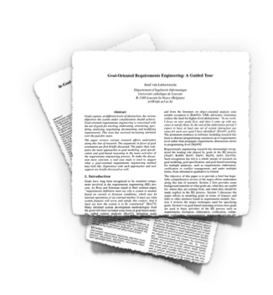
Example: Goal-oriented RE
Papers published [1]: 966
Papers including a case study [1]: 131
Studies involving practitioners [2]: 20
Practitioners actually using GORE [3]: ~ 5%
[1] Horkoff et al. Goal-Oriented Requirements Engineering: A Systematic Literature Map, 2016
[2] Mavin, et al. Does Goal-Oriented Requirements Engineering Achieve its Goal?, 2017
[3] Mendez et al. Naming the Pain in Requirements Engineering Initiative – www.napire.org

Slide 31
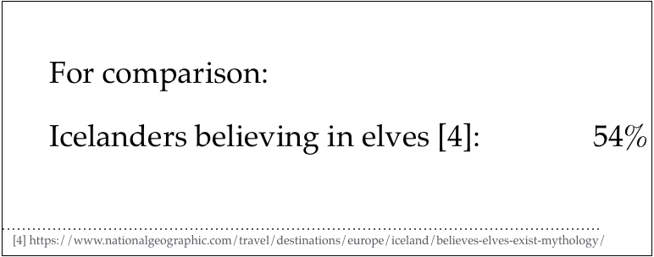
Example: Goal-oriented RE
Papers published [1]: 966
Papers including a case study [1]: 131
Studies involving practitioners [2]: 20
Practitioners actually using GORE [3]: ~ 5%
[1] Horkoff et al. Goal-Oriented Requirements Engineering: A Systematic Literature Map, 2016
[2] Mavin, et al. Does Goal-Oriented Requirements Engineering Achieve its Goal?, 2017
[3] Mendez et al. Naming the Pain in Requirements Engineering Initiative – www.napire.org

Slide 32
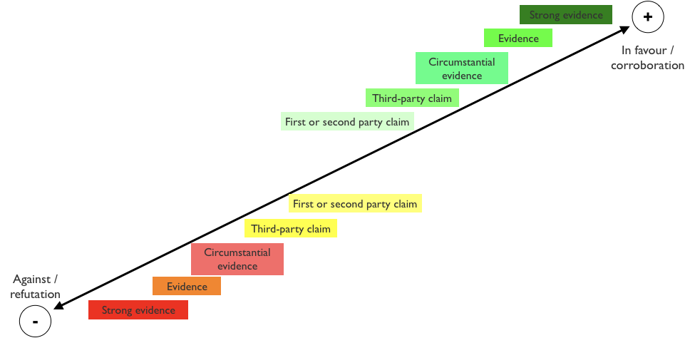
Current state of evidence in Software Engineering
Available studies often…
… remain isolated
… discuss little (to no) relation to existing evidence
… strengthen confidence on own hopes (and don’t report anything around)
… don’t report negative results
In most cases, we are here
Source (levels of evidence): Wohlin. An Evidence Profile for Software Engineering Research and Practice, 2013.

Slide 33
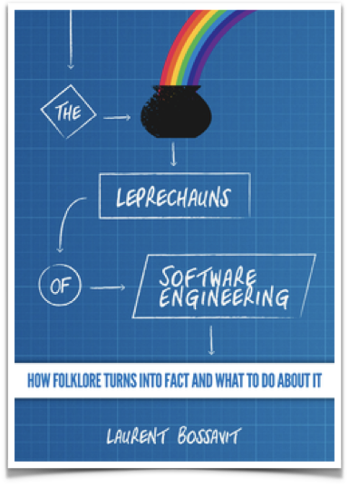
Conventional Wisdom in SE
“Leprechauns”: Folklore turned into facts
Emerge from times where claims by authorities were treated as “facts”
Reasons manifold:
Lack of empirical awareness
Neglecting particularities of practical contexts
Neglecting relation to existing evidence
No proper citations (one side of the medal, over-conclusions, etc.)
Lack of data
…

Slide 34
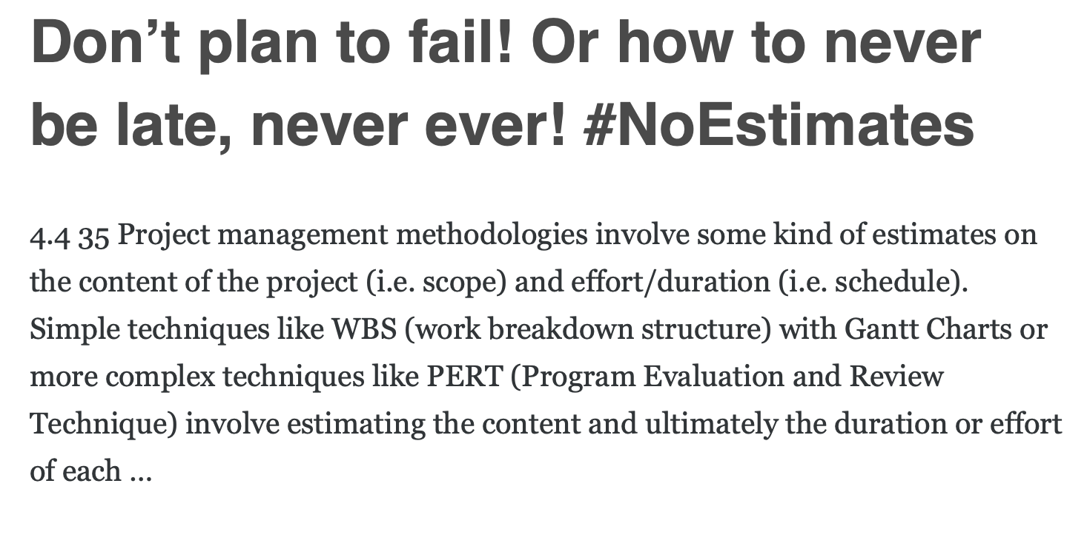
Exemplary symptoms: #NoEstimates
What are benefits and drawbacks of #noestimates?
What are project circumstances/ characteristics under which such philosophy applies?
„The key insight is this: spiraling delays are normal in projects. They are entirely predictable (as in we know they will happen), but also entirely unpredictable (as in we don’t know which delays will spiral out of control). So we must prepare for them. […] core principle of #NoEstimates: Always be ready to stop the project and deliver value, at any time.”
So far: no evidence, no trade-offs, no balanced discussion, but only rather “religious” discussions.
Source (first post on this topic): http://zuill.us/WoodyZuill/2012/12/10/no-estimate-programming-series-intro-post/

Slide 35
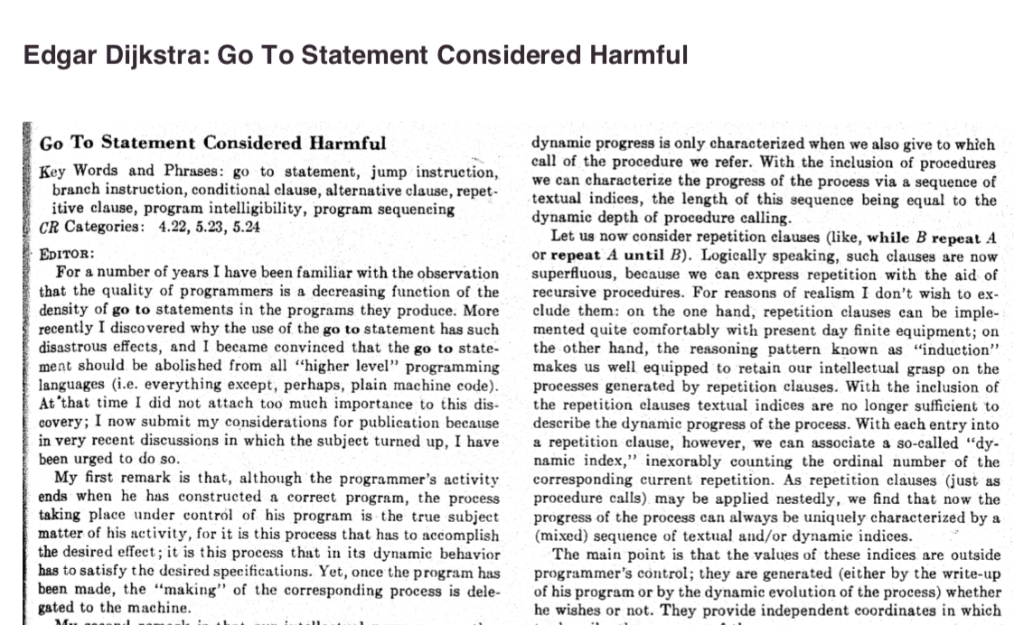
Exemplary “leprechaun”: Go To statements considered harmful
1968
Public exchange based on reasoning by argument (rationalist arguments)...
… finally tackled by one empirical study nearly 50 years later.
[1] Edsger Dijkstra . Go To Statement Considered Harmful. Communications of the ACM, 1968.
[2] Frank Rubin. ”GOTO Considered Harmful" Considered Harmful. Communications of the ACM, 1969.
[3] Donald Moore et al. " 'GOTO Considered Harmful' Considered Harmful" Considered Harmful?" Communications of the ACM, 1987.
[4] Nagappan et al. An empirical study of goto in C code from GitHub repositories, 2015.

Slide 36
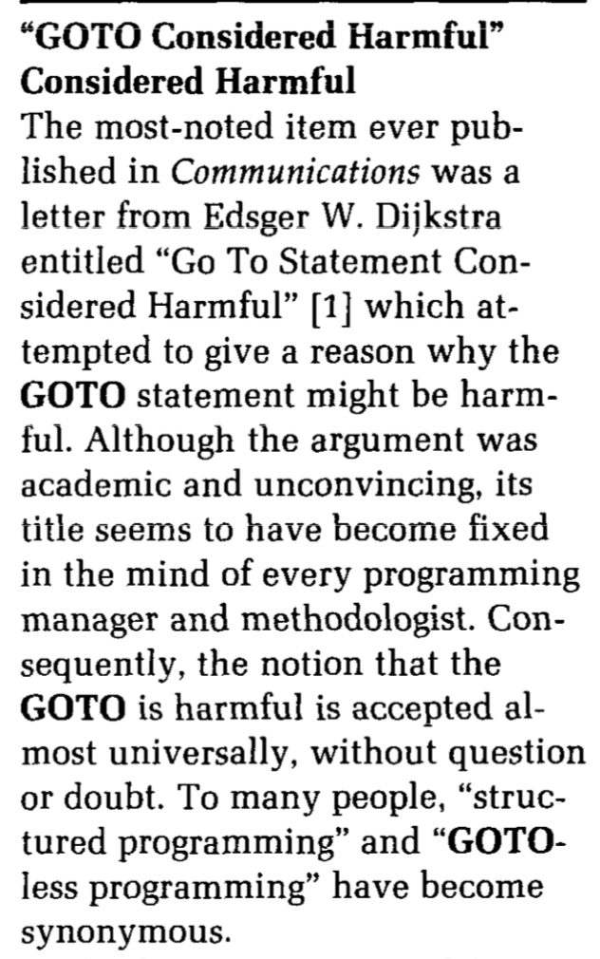
Exemplary “leprechaun”: Go To statements considered harmful
1968
1969
Public exchange based on reasoning by argument (rationalist arguments)...
… finally tackled by one empirical study nearly 50 years later.
[1] Edsger Dijkstra . Go To Statement Considered Harmful. Communications of the ACM, 1968.
[2] Frank Rubin. ”GOTO Considered Harmful" Considered Harmful. Communications of the ACM, 1969.
[3] Donald Moore et al. " 'GOTO Considered Harmful' Considered Harmful" Considered Harmful?" Communications of the ACM, 1987.
[4] Nagappan et al. An empirical study of goto in C code from GitHub repositories, 2015.

Slide 37
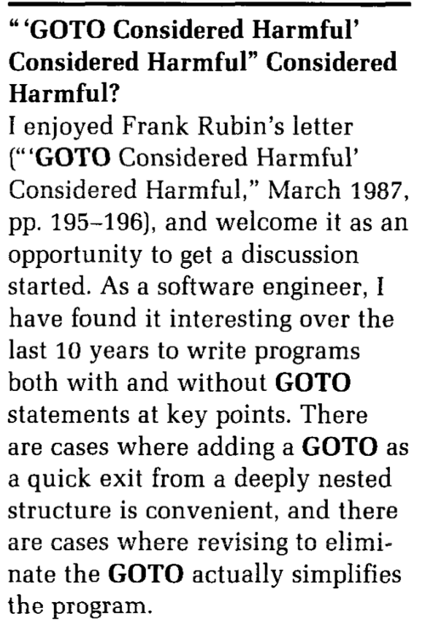
Exemplary “leprechaun”: Go To statements considered harmful
1968
1969
1987
Public exchange based on reasoning by argument (rationalist arguments)...
… finally tackled by one empirical study nearly 50 years later.
[1] Edsger Dijkstra . Go To Statement Considered Harmful. Communications of the ACM, 1968.
[2] Frank Rubin. ”GOTO Considered Harmful" Considered Harmful. Communications of the ACM, 1969.
[3] Donald Moore et al. " 'GOTO Considered Harmful' Considered Harmful" Considered Harmful?" Communications of the ACM, 1987.
[4] Nagappan et al. An empirical study of goto in C code from GitHub repositories, 2015.

Slide 38
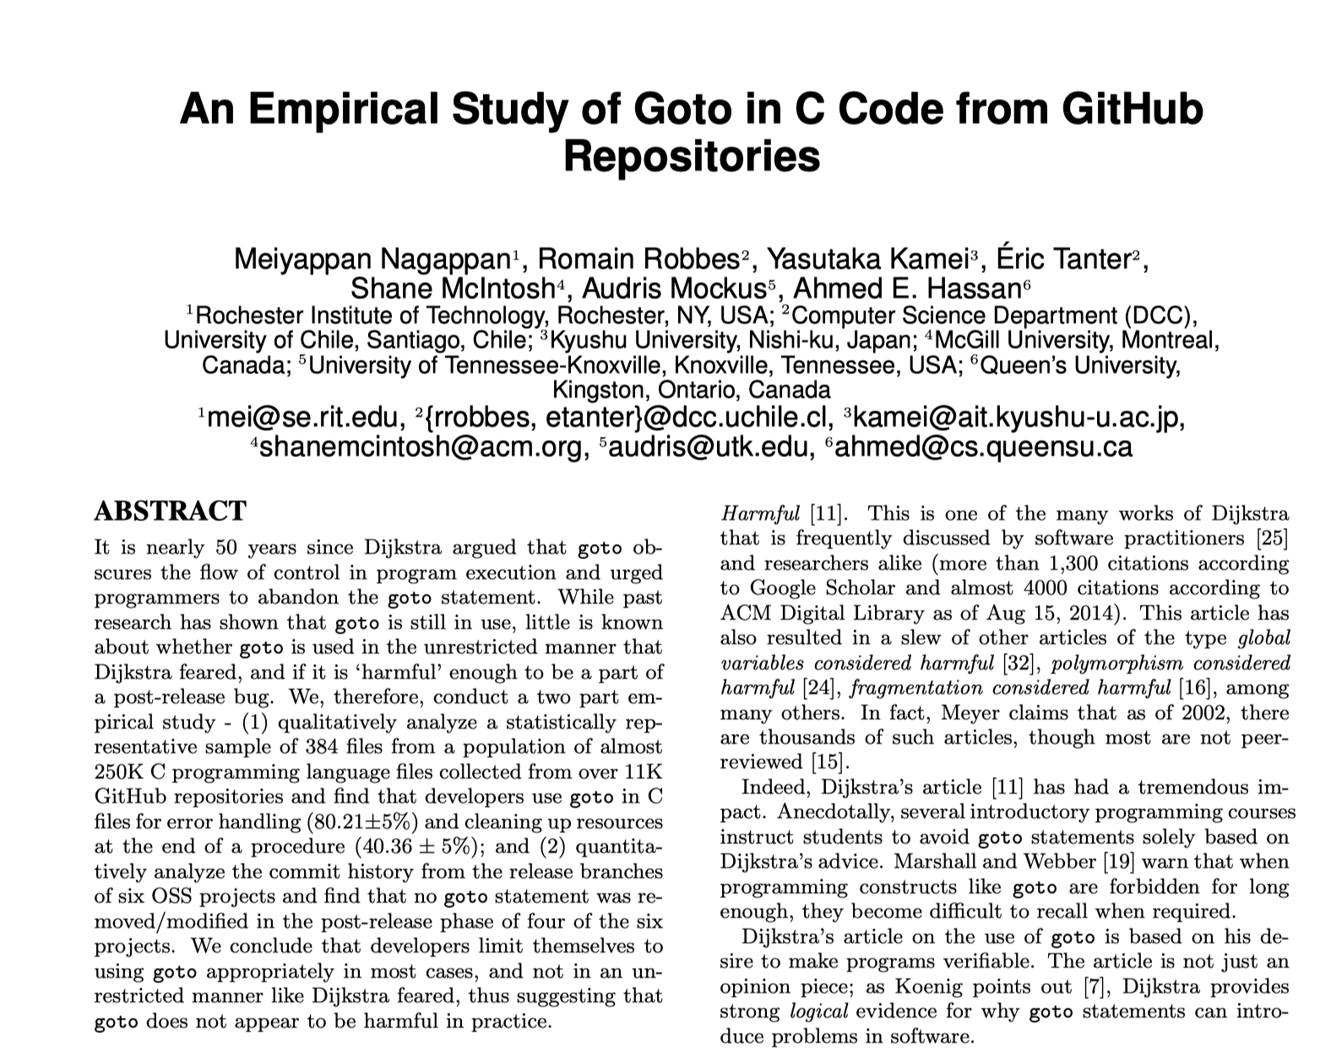
Exemplary “leprechaun”: Go To statements considered harmful
1968
2015
“We conclude that developers limit themselves to using goto appropriately, [not] like Dijkstra feared, [thus] goto does not appear to be harmful in practice.”
Public exchange based on reasoning by argument (rationalist arguments)...
… finally tackled by one empirical study nearly 50 years later.
[1] Edsger Dijkstra . Go To Statement Considered Harmful. Communications of the ACM, 1968.
[2] Frank Rubin. ”GOTO Considered Harmful" Considered Harmful. Communications of the ACM, 1969.
[3] Donald Moore et al. " 'GOTO Considered Harmful' Considered Harmful" Considered Harmful?" Communications of the ACM, 1987.
[4] Nagappan et al. An empirical study of goto in C code from GitHub repositories, 2015.

Slide 39
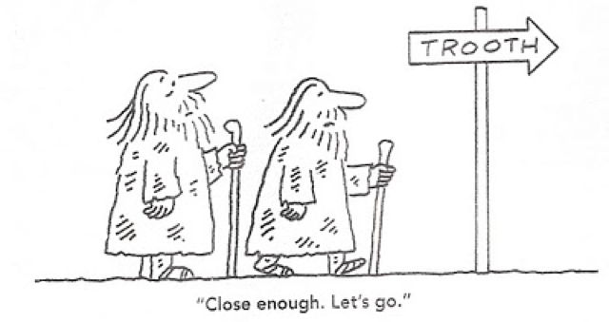
Key Takeaway
The current state of evidence in Software Engineering is still weak
Practical relevance and impact?
Potential for transfer into practice and adoption?
But there is hope…
Importance of empirical research recognised
Growth of a strong research community over last two decades

Slide 40
Outline
What is Empirical Software Engineering?
Why do we need Empirical Software Engineering?
What are the perspectives in Empirical Software Engineering?

Slide 41
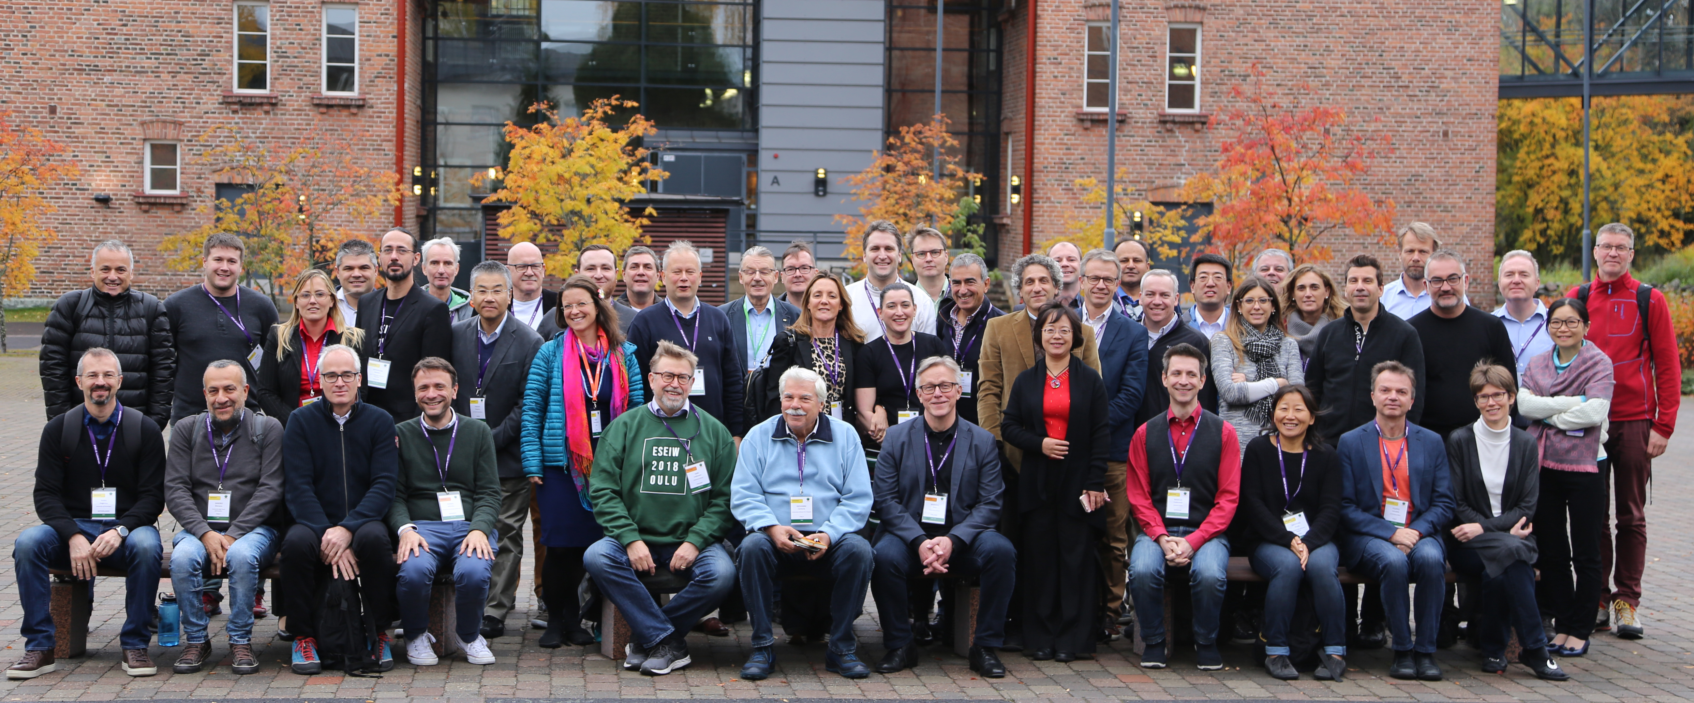
Empirical Software Engineering Community
Empirical Software Engineering research community 2018 (Oulu, Finland)

Slide 42
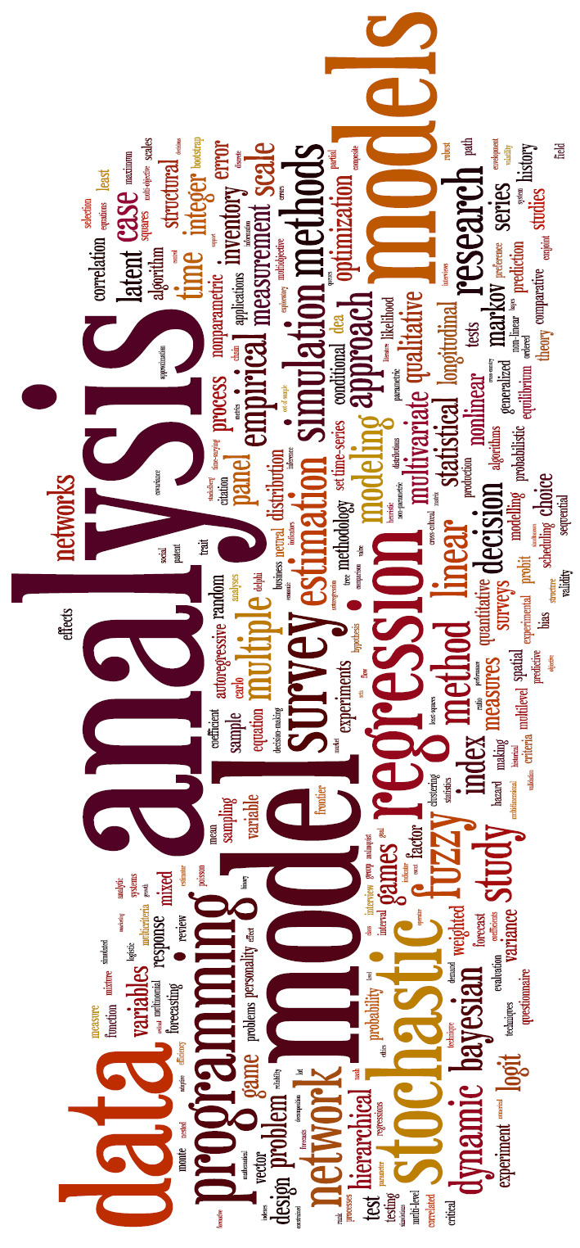
Goals and perspectives in Empirical Software Engineering
Provide tools and methods for empirical research
Establish strong Software Engineering theories
Eradicate conventional wisdom (“leprechauns”)
Various settings
Industry settings
Research initiatives from the community
Publicly funded research projects

Slide 43

Example 1: Industry setting (as part of a Academia-industry collaboration)
Challenge: Role and Relevance of RE to Business Success unclear
Goal: “Find the proper Problem before solving it properly”
Exemplary question: “How does Customer Satisfaction depend on RE?”

Slide 44
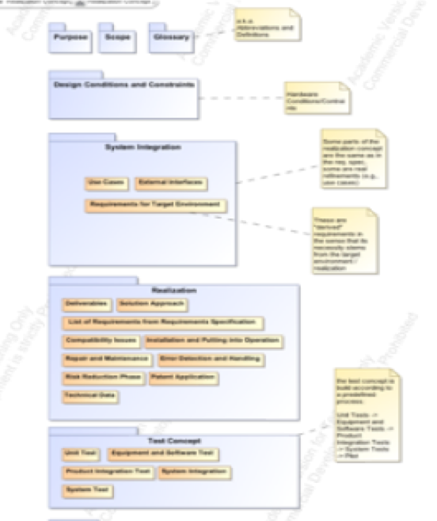
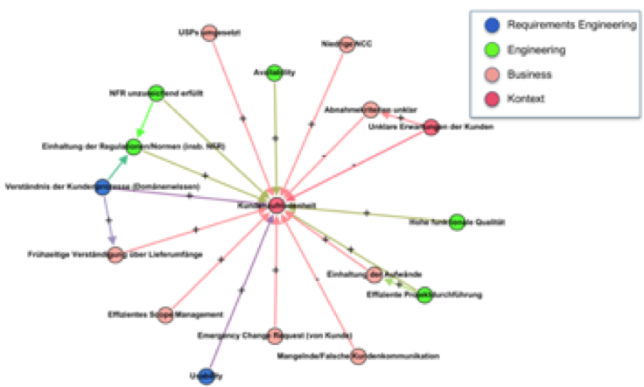
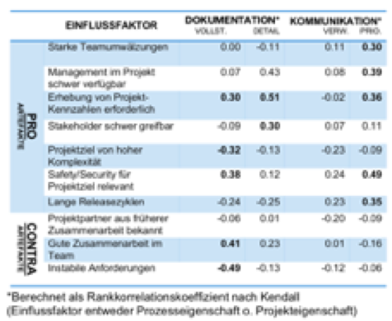
How relevant is RE to business success?
How is RE conducted at project level?
How does customer satisfaction depend on factors in RE?
What factors do influence the way RE is conducted?
Document Analysis
Interviews
Online Survey

Slide 45
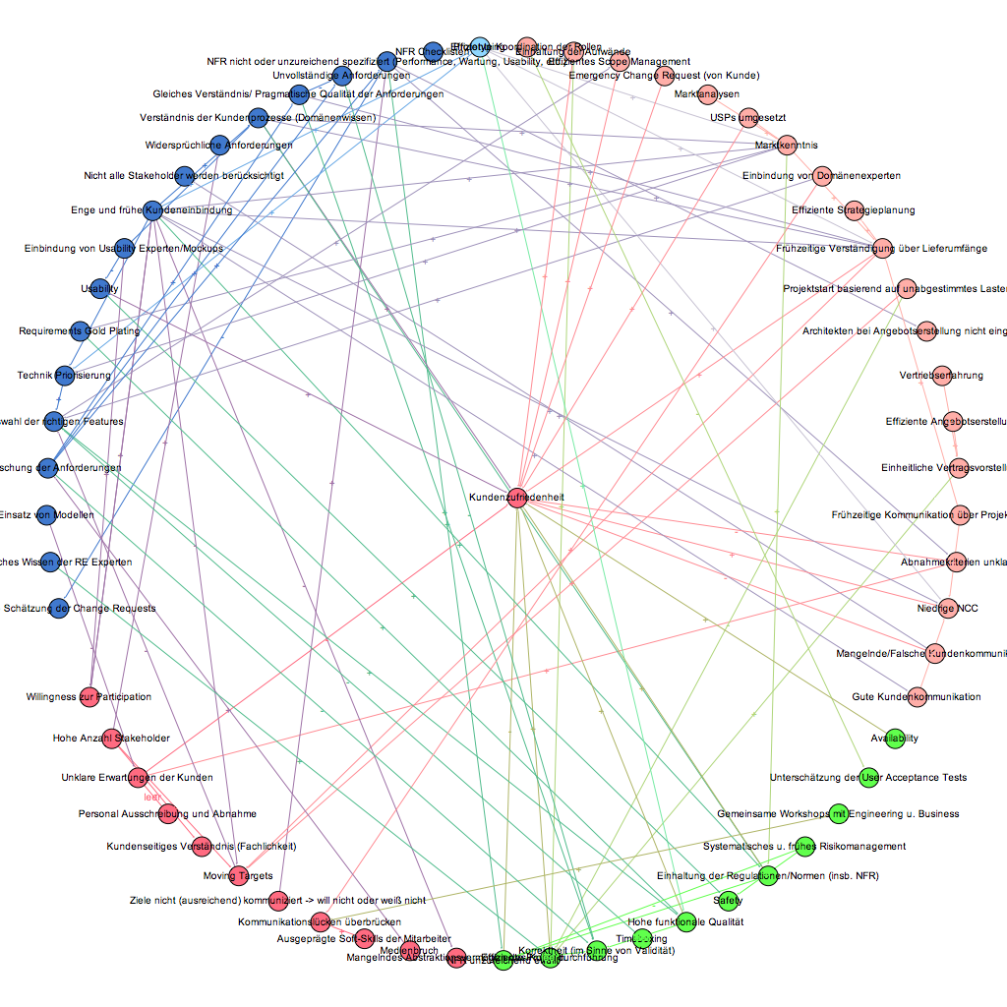
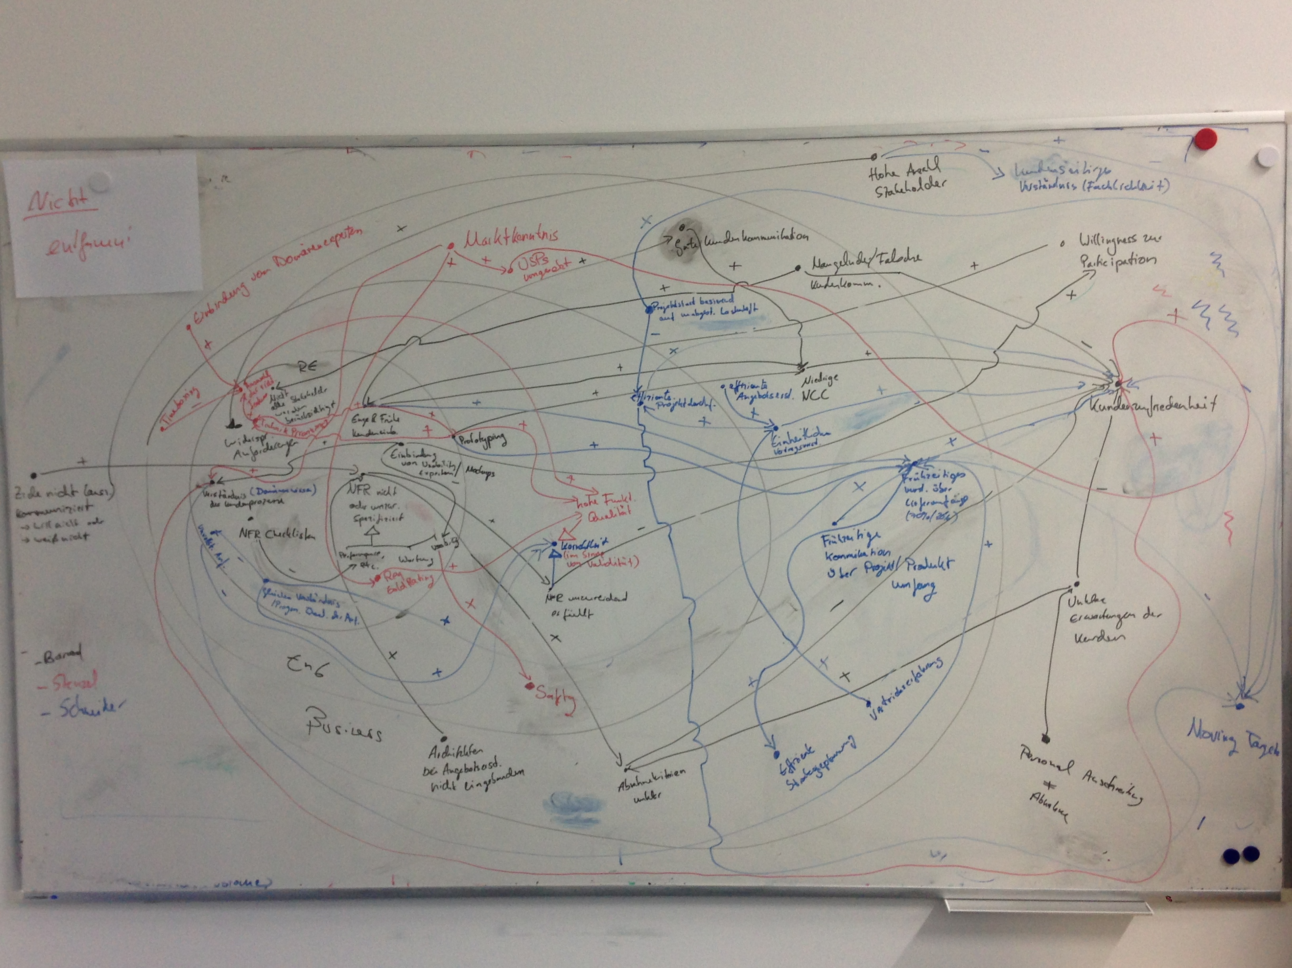
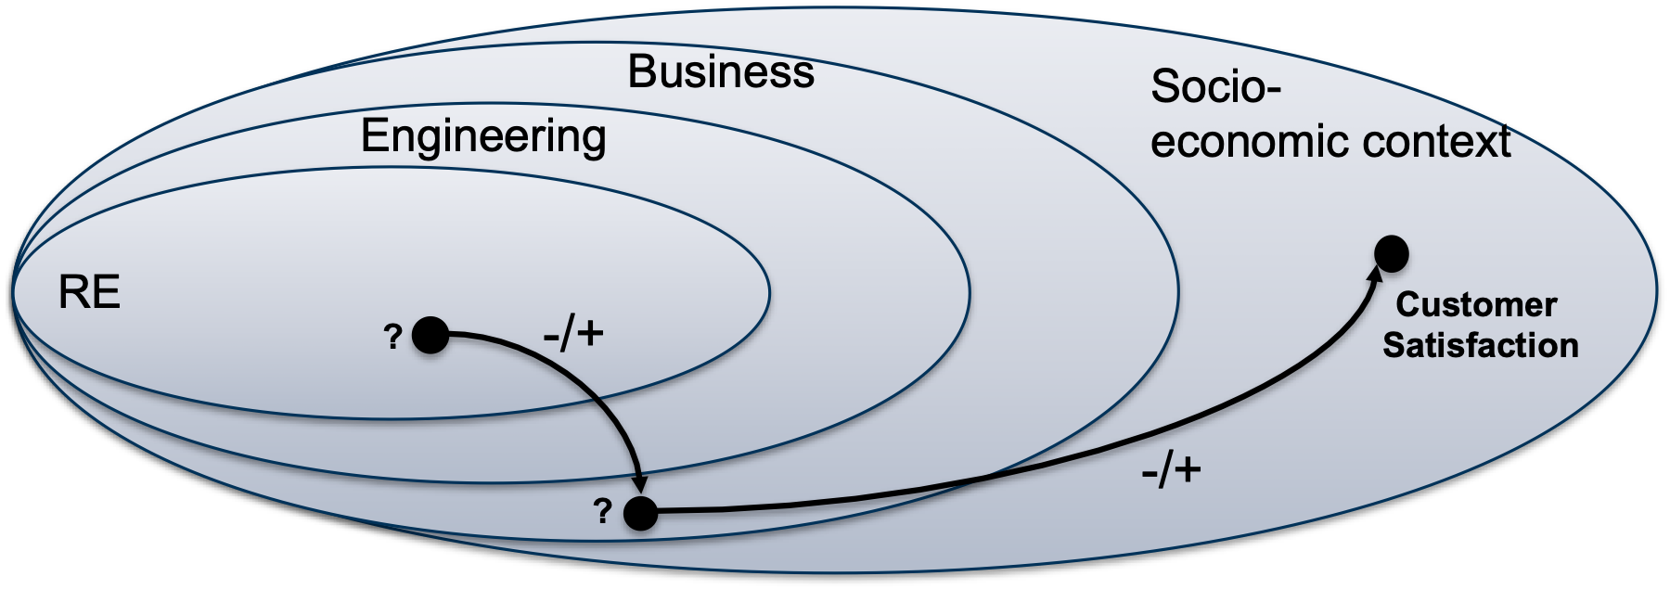
How does Customer Satisfaction depend on RE?
Interviews of different roles in different project settings
Root cause analysis of customer satisfaction to phenomena in RE

Slide 46
RE is a recognised basis for…
… effective product and portfolio management, feature sizing, and project organisation (feature planning, prioritisation, and sizing, resource and expertise planning, technology prioritisations)
… clear (dev.) process interfaces, responsibilities, and liability in distributed environments
… effective risk management and identification of moving target (and wicked problems) (basis for “good-enough RE” and potential infusion of new RE techniques such as Design Thinking)
… (regulatory) compliance: safety, security, and usability
… increased stakeholder involvement and participation (accountability but also motivation)
… (…)

Slide 47
RE is a recognised basis for…

Slide 48



Example 2: Research initiatives
Background: Requirements Engineering research often dominated by conventional wisdom
Challenge: What research topics are of high practical relevance?
What are practices and problems in practical Requirements Engineering environments?
NaPiRE
How do practitioners perceive the relevance of contributions by the RE research community?
How do practitioners perceive the relevance of RE standards?
Exemplary initiatives in context of IREB working group (“IREB Research”)

Slide 49
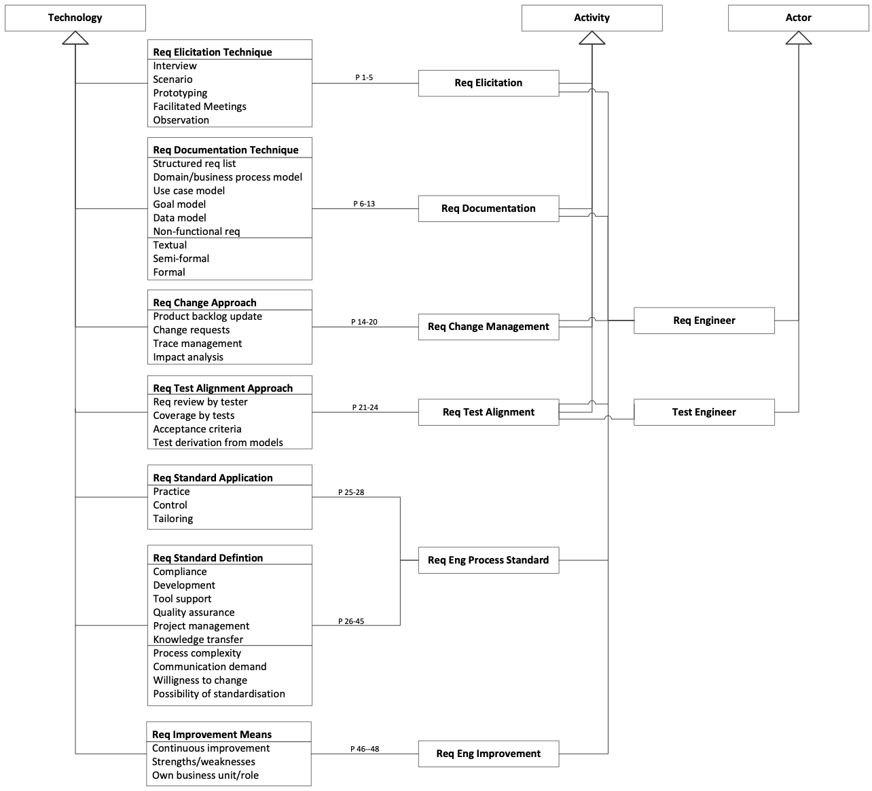
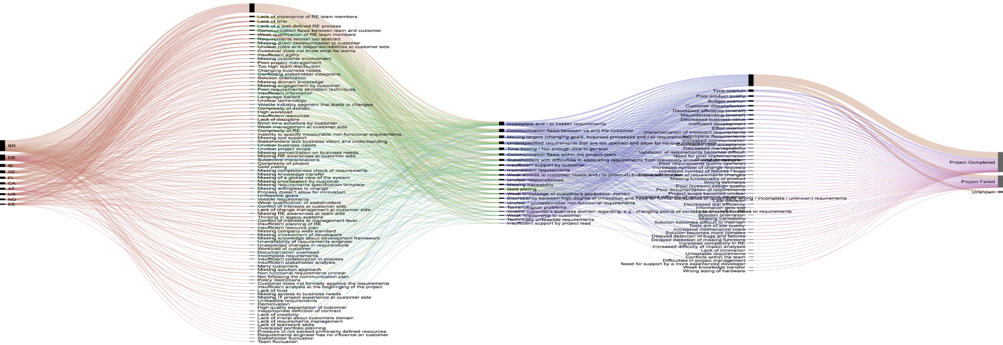
Naming the Pain in Requirements Engineering
NaPiRE
Objectives: Build theory on RE practices used in industry and on problems practitioners experience
Research method: Large-scale survey research
Practices
Problems, causes, and effects
www.napire.org

Slide 50
First theory on Requirements Engineering practices and problems supporting problem-driven research
Causes
Effects
Context
Problems

Slide 51
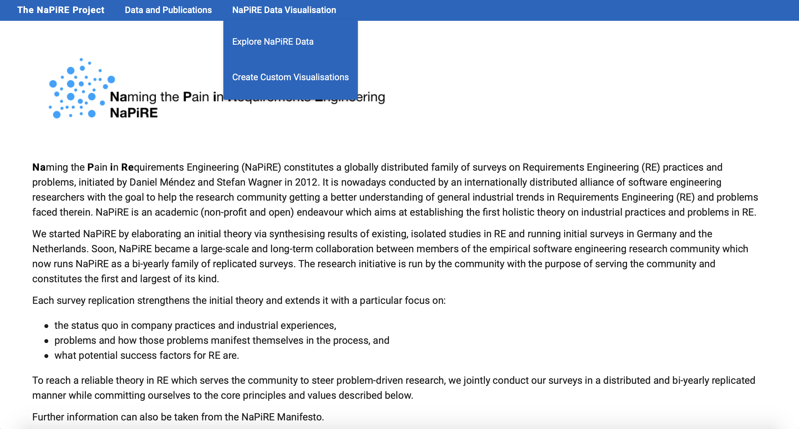
See yourself and play with the interactive data visualisation: www.napire.org
Interactive data visualisation

Slide 52
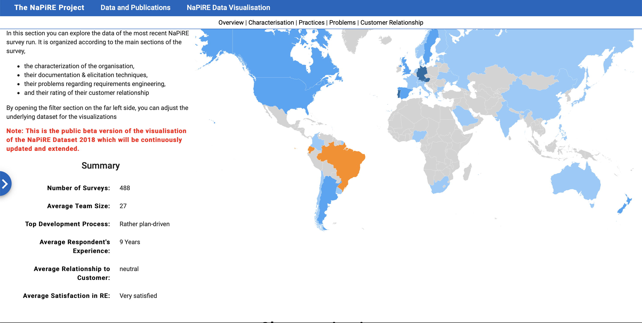
See yourself and play with the interactive data visualisation: www.napire.org
Filter data by various criteria

Slide 53
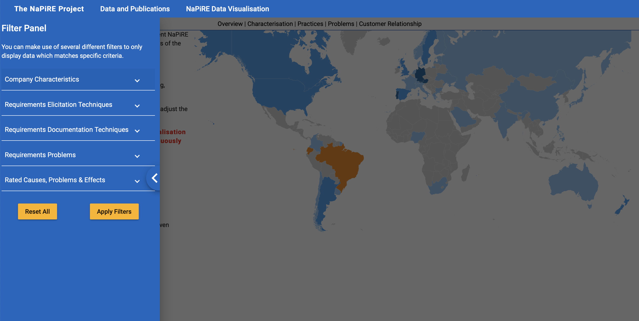
See yourself and play with the interactive data visualisation: www.napire.org

Slide 54
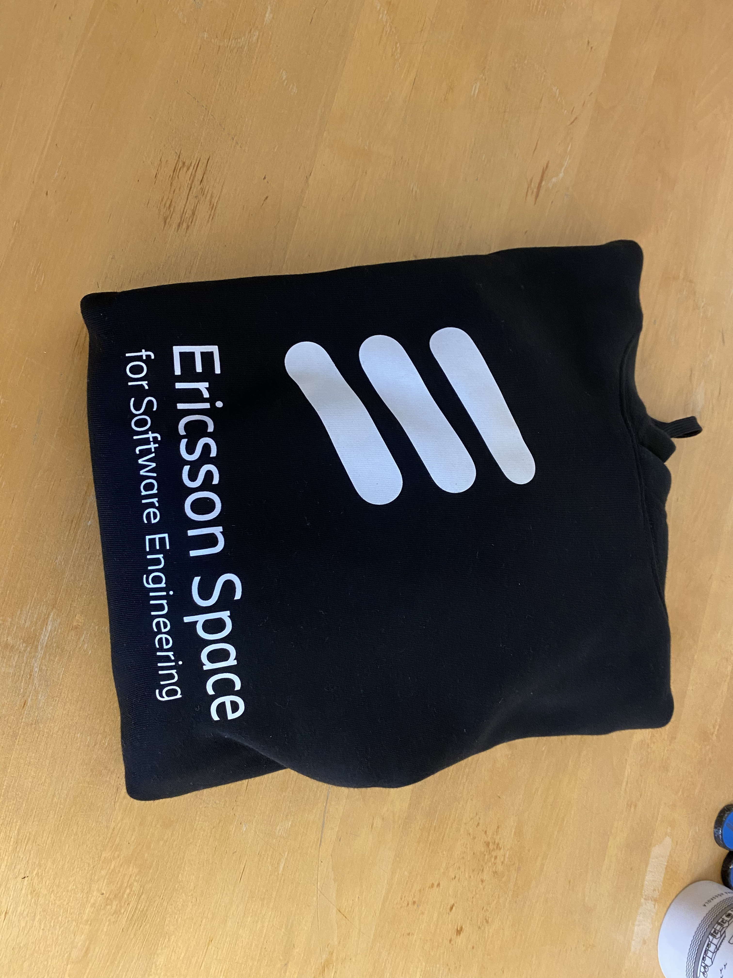
See yourself and play with the interactive data visualisation: www.napire.org
Quiz
What is the most frequently stated problem companies face in RE when using a rather agile software development process model?
?
Incomplete or hidden requirements
?
Unprecise / Unmeasurable requirements
?
Communication problems
* Prize Ericsson Space sweater ☺

Slide 55
See yourself and play with the interactive data visualisation: www.napire.org
Quiz
What is the most frequently stated problem companies face in RE when using a rather agile software development process model?
Incomplete or hidden requirements
Unprecise / Unmeasurable requirements
Communication problems
* Prize Ericsson Space sweater ☺

Slide 56

Example 3: Publicly funded research projects
Background: Empirical software engineering is advancing already, but it needs to integrate multiple competences:
Data-centric automation
Value orientation
Human-centricity
Goal: Extend empirical SE to solve next generation SE problems.
https://rethought.se

Slide 57
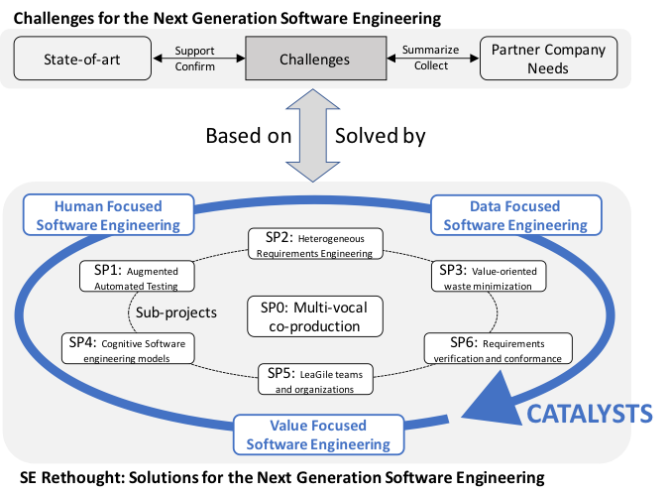











See yourself: www.rethought.se

Slide 58
Outline
What is Empirical Software Engineering?
Why do we need Empirical Software Engineering?
What are the perspectives in Empirical Software Engineering?

Slide 59
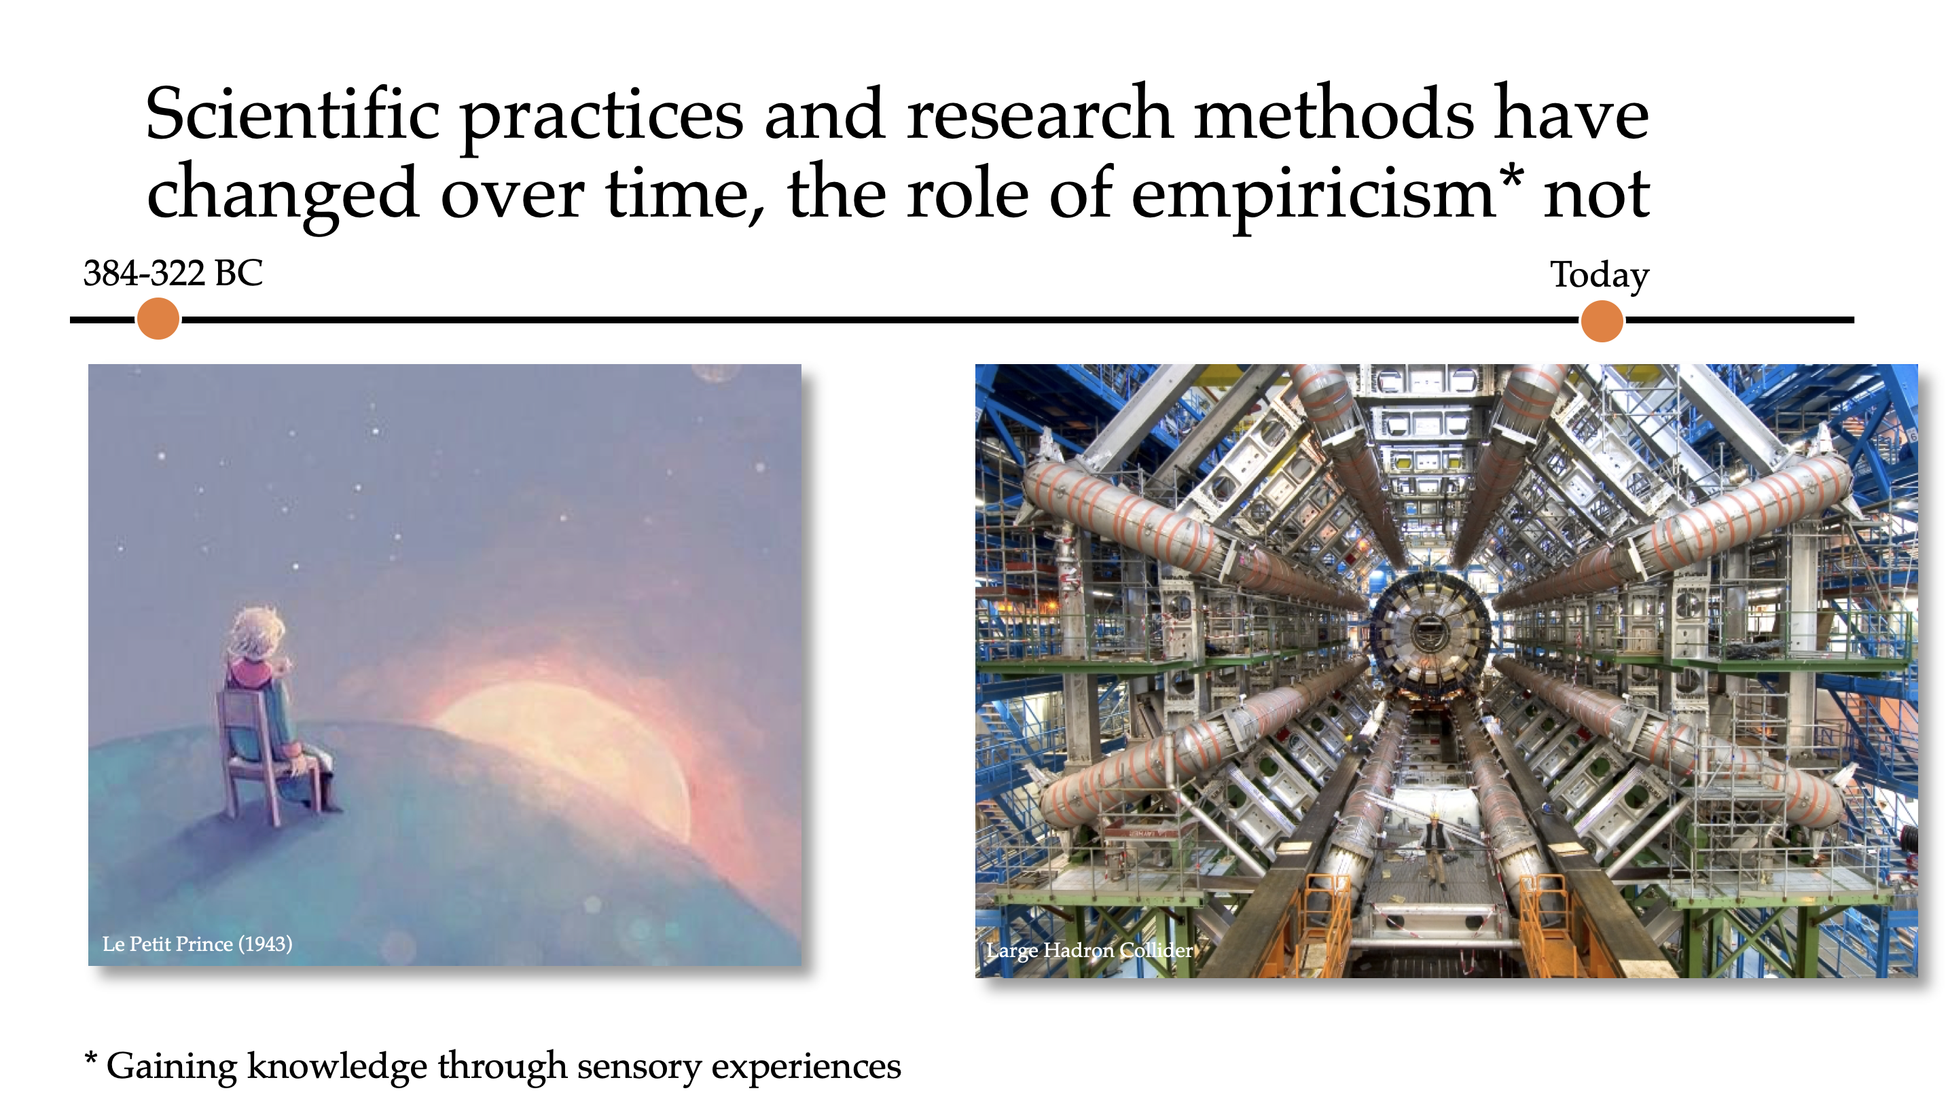
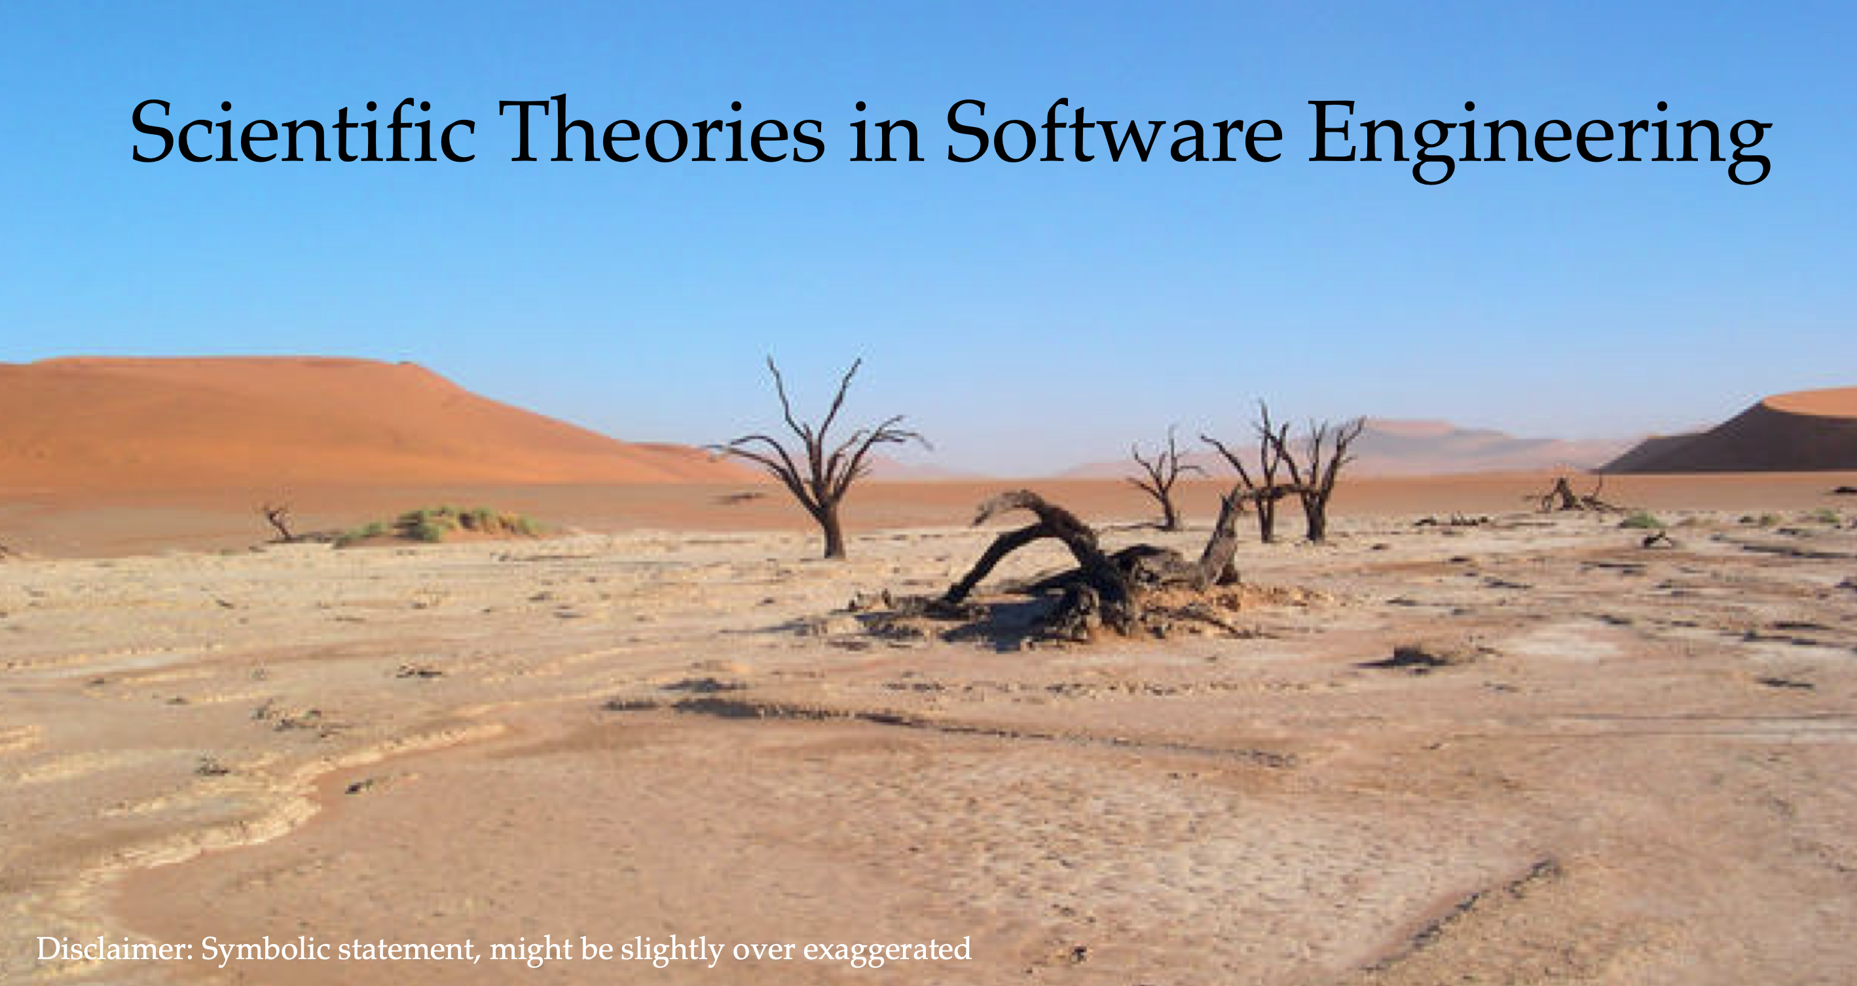
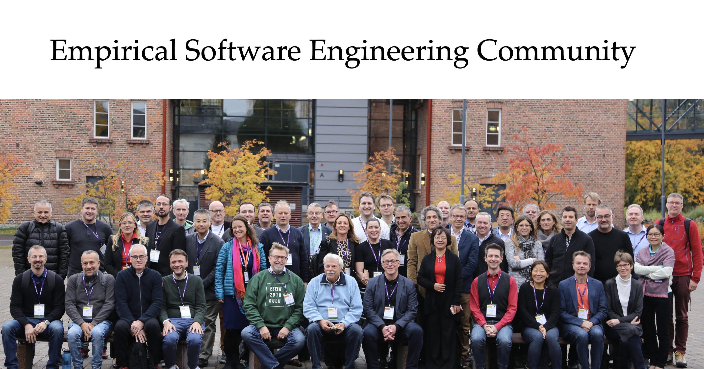
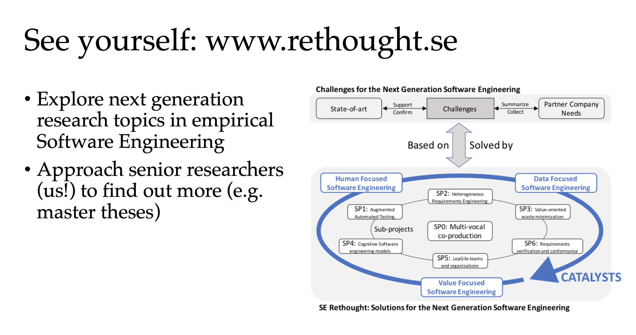
Key Takeaways
Empirical research is important to turn software engineering into a scientific discipline
The state of evidence in Software Engineering is still weak
The growth of a community of empirical researchers and practitioners is promising
We are now entering the next generation of empirical Software Engineering research

